Slide 1





RIVER REVERSALS AND THE METABOLIC REGIMES OF FLORIDA’S SPRINGS
Samantha T. Howley¹, Yuseung Shin¹, Matt Cohen²
School of Natural Resources and Environment (1)
School of Natural Forest, Fisheries, and Geomatic Sciences (2)
University of Florida | IFAS, Gainesville, FL 32611

Slide 2
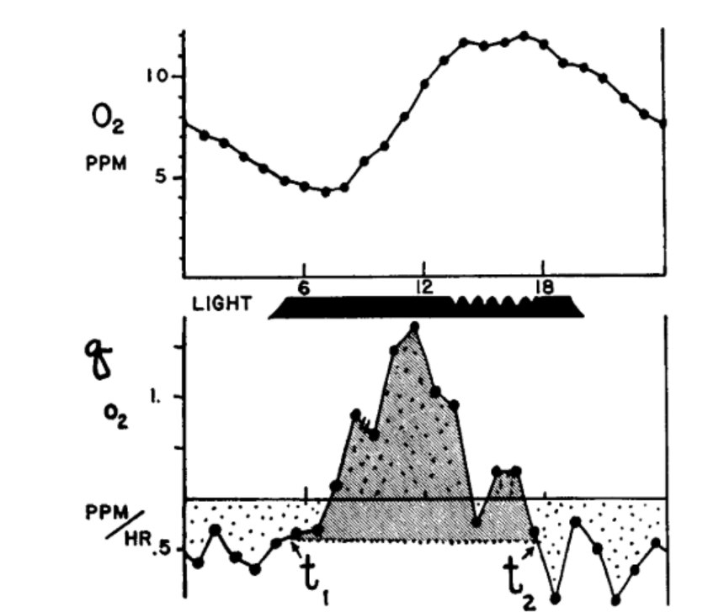

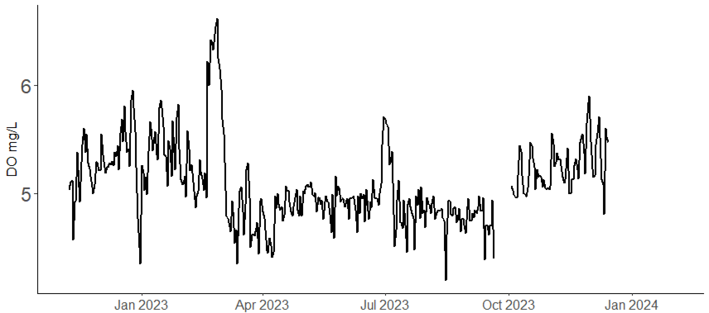
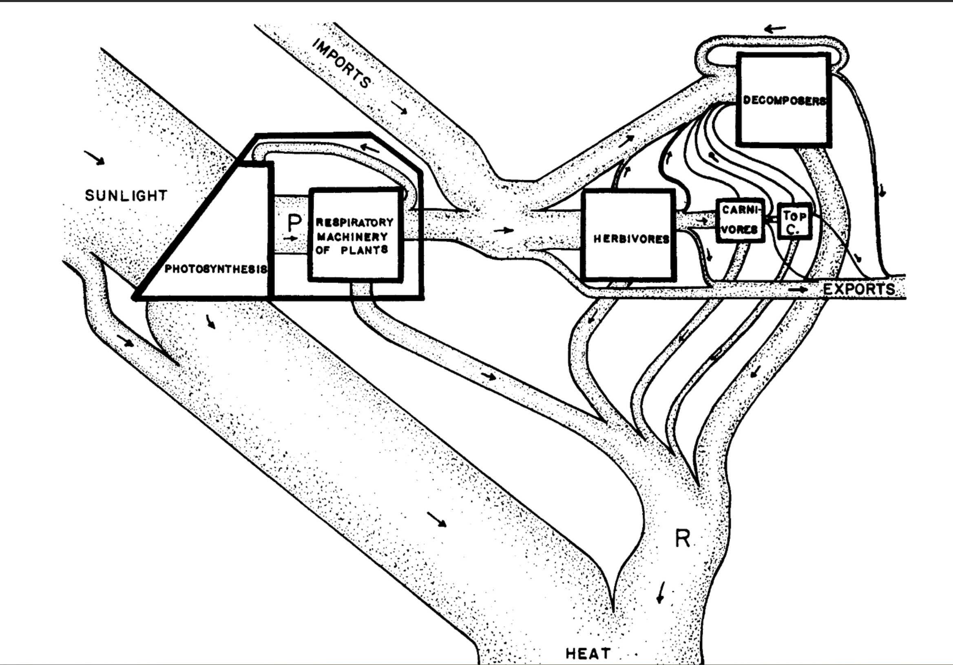

Metabolic Regime: the productivity of an ecosystem over a study period.
Stream metabolism: the energy flow through out an ecosystem via gross primary
Productivity (GPP) and ecosystem respiration (ER).
Net Ecosystem Productivity (NEP) = GPP-ER
Gross Primary Productivity (GPP): total photosynthesis; producing oxygen.
Ecosystem Respiration (ER): total respiration; consuming oxygen.
Primary Production of Flowing Waters (1956), HT Odum
Notes:
Before I begin, the metabolic regime of a stream or rivers is it productivity over a study period.
And this is first found by modeling a stream’s daily metabolism
Stream metabolism, simply, is the energy flow through out an ecosystem via
gross primary productivity, GPP, organisms producing oxygen and
Ecosystem respiration, ER, consuming oxygen
Therefore, stream metabolism is estimated by tracking the hourly changes in dissolved oxygen
These photos are from the classic publication, the Primary Production of Flowing Waters where HT Odum researched the metabolic regime of… North Florida’s springs ☺
Historically, modeling stream metabolism was challenging. Each of these little dots was hand sampled.
Classic stream metabolism literature only encompassed a few days under normal, conditions.
In there present, where high-frequency, durable DO sensors are available, stream metabolism experiments are less-energy intensive, allowing users to explore streams productivity under non-disturbed and disturbed periods.

Slide 3









Influences on stream metabolism:
Disturbance
Season
N-P
Nutrients
Biomass density
Materials
Depth (stage)
Canopy Cover
Flow
Temperature
Energy
GPP
Energy
Materials
ER
Temperature
Acuña et al., 2004; Fuss & Smock, 1996;Meyer & Edwards, 1990; Mulholland et al., 2001; Bernhardt et al., 2019; Hall et al., 2015; Julian et al., 2008; LeRoy Poff et al., 1997
Light Availability
Organic Matter
Notes:
Stream metabolism, and therefore stream metabolic regime is dictated by a multitude of
But light availability, OM quality/quantity, and flow are the majoring determining factors.
Light powers photosynthesis, OM is influential for ER, and flow velocity determines solute export, biomass density and influences water clarity

Slide 4

Welcome to North Florida’s Springs
Odum, 1956; 1957
Notes:
Which brings me to my study sites, North Florida springs! A terrible place to do fieldwork!
Due to the Upper Florida aquifer (the UFA) discharging groundwater to the springs at a near constant rate and at a near constat temp of 73 degrees F year-round, FL’s springs have some of the clearest, stable and most productive waters in the world
When HT Odum studied N FL springs, specifically Ichetucknee and Silver river, he described productive, clear, stable-flowing, waters with a distinct upstream and downstream.

Slide 5

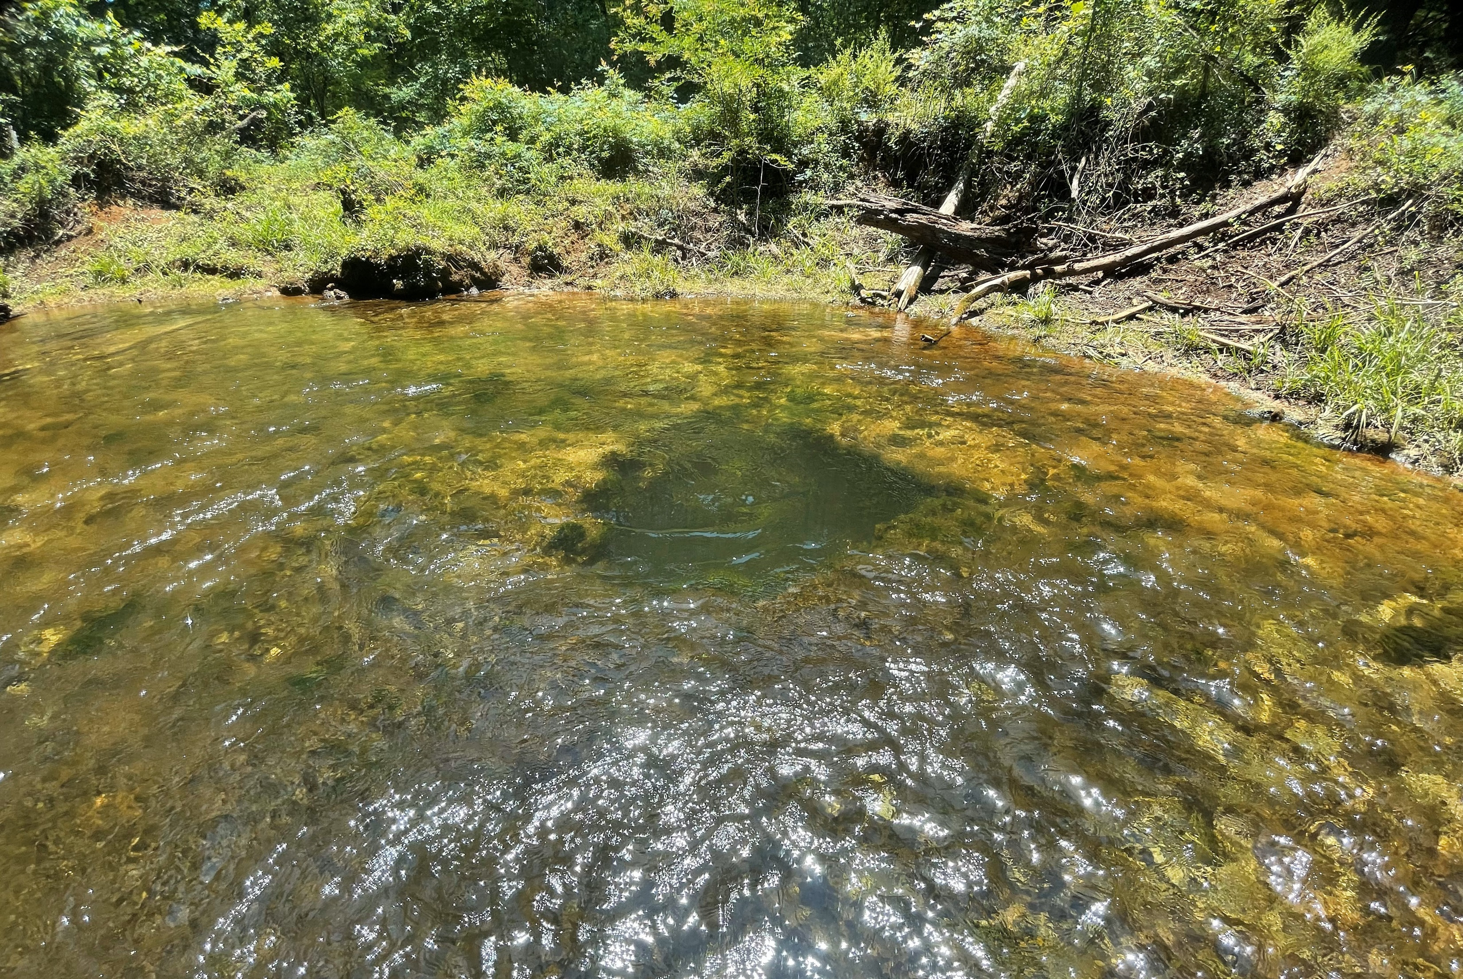
…but they don’t all look like that…
Ichetucknee Blue Hole
Allen Mill Pond
Notes:
An although that is true for Ichetucknee and Silver River, that does not apply to all N Fl springs. Most reaches are much shorter (~500m), and their water is more green than blue

Slide 6


…and they have site-specific flow regimes…
Gilchrist Blue Spring
Notes:
Nor do they all have stable flow regimes. Although these springs don’t experience drought, they do flood…

Slide 7






River reversals (backwater floods)
River Reversals (RR)
High stage events
Brown out
Flow reversal
Increasing Disturbance Magnitude
Hensley et al. 2017
Normal
Notes:
Most of Florida’s springs discharge into a downstream blackwater river.
Spring vents are located at higher elevation with the river-spring confluence at lower elevation.
During flood conditions, the river’s water level will rise, minimizing the elevation difference between the spring and the river
When this happens, the river will block spring Q, raising stage and slowing flow
In the most severe scenarios, a backwater effect happens, where the river will flow into the spring run.
A high stage event is when the river acts like dam. Spring discharge is inhibited, stage is raised, and flow is slowed
A brownout occurs when the river enters the run and mix with spring water. Stage is raised. flow is stopped, and water clarity is reduced
A flow reversals occurs when the river displaces spring water. In this situation, the headwaters will have switched, flow is backwards, stage is high, and the water is tannic.

Slide 8
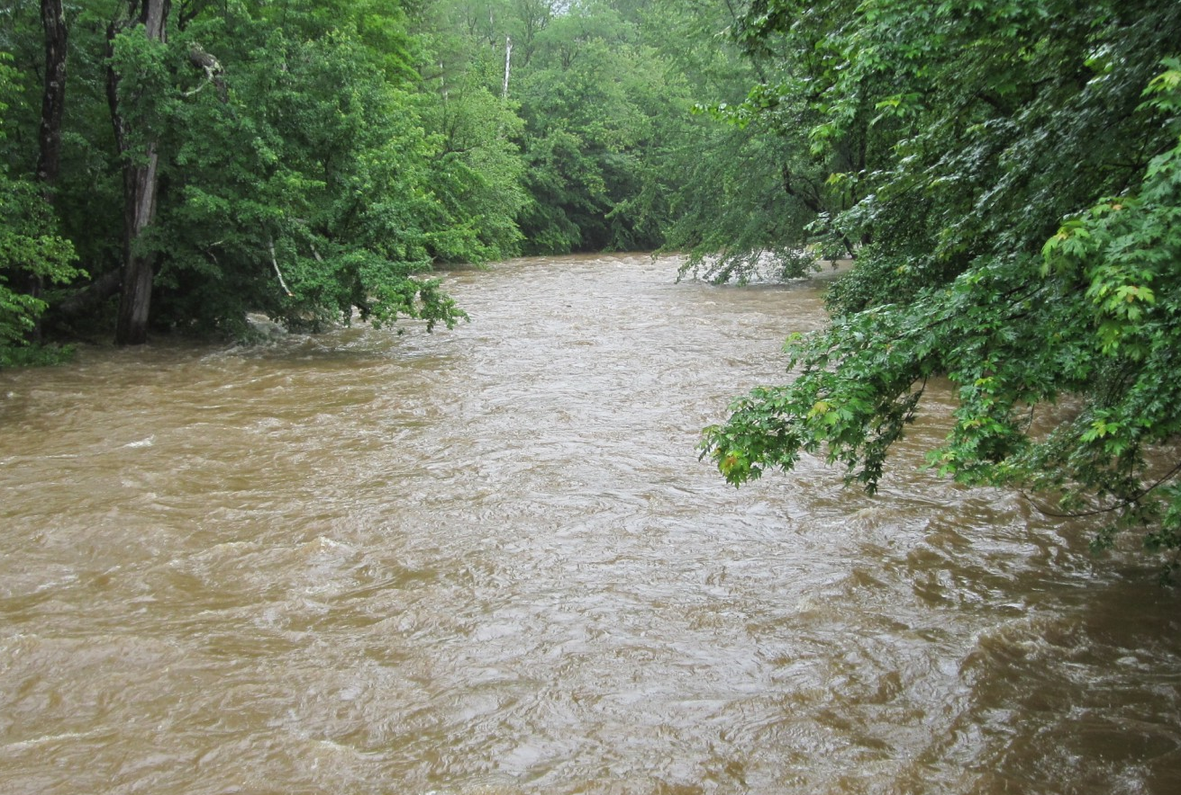
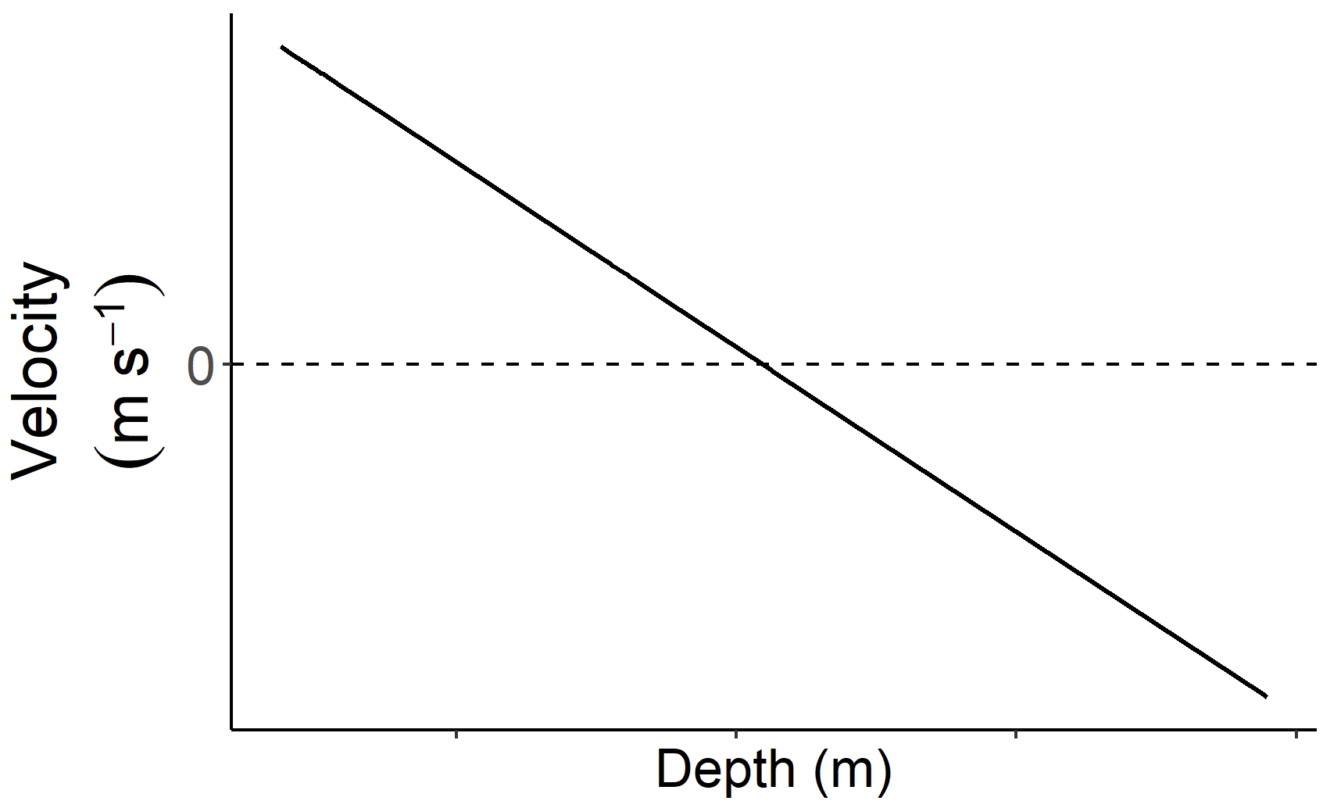




Spring-runs do not experience bed scour during floods.
Bed Scour
Notes:
Typical stream floods and river reversals are similar.
They both experience an increase stage and reduced water clarity, but springs do not experience bed scour
In most streams, fast-flowing flood-waters causes bed scour, the physical removal of a stream's benthic material
During a river reversal, flow is diminished so there is no bed scour.
The benthos is retained but under meters of water, sometimes blackwater

Slide 9
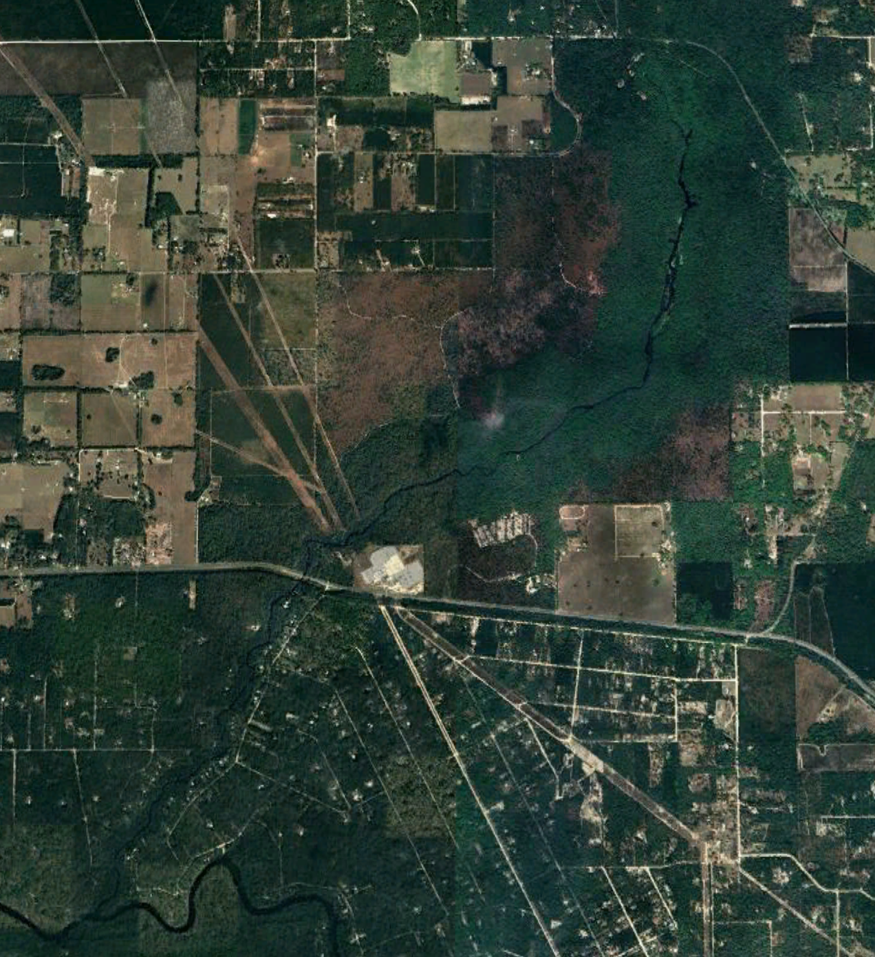




Florida springs belong to a gradient of flow regimes.
Ichetucknee River
Gilchrist Blue Spring
Rum Island Spring
Disturbance Regime
distance
Susceptibility to River Reversals:
elevation
Notes:
Some springs reverse with every major rain, others experience a high stage event every couple of years
A springs susceptibility to a river reversal is a largely dependent 1) its vent elevation and 2) its proximity to its receiving blackwater river (how long its spring run is)
Ichetucknee river is a 8-mile long spring-run, is rarely disturbed and is known for its clear waters and thick mats of macrophytes
but shorter springs that experience a quarter to half the year brown (such as rum island ) tend to have less biodiversity and are murkier

Slide 10

What are the metabolic impacts of spring river-reversals?
H1. Due to the occlusion of light, Spring-run productivity will decline and respiration rates will increase.
Are springs with greater disturbance frequency less productive than less disturbed springs?
H2. Flood magnitude will be positively correlated with metabolic recovery time and metabolic reduction.
H3. Frequently disturbed springs will have less stable metabolic regimes than rarely disturbed springs.
Notes:
Which brings me to my research topics.
I wanted to explore the metabolic impacts of river-reversals
And understand, if and how disturbance influences spring typology specifically…

Slide 11
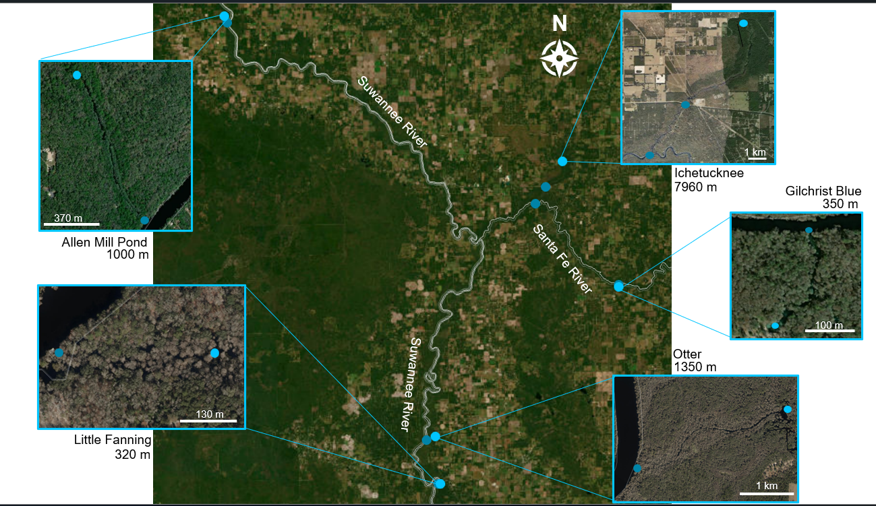

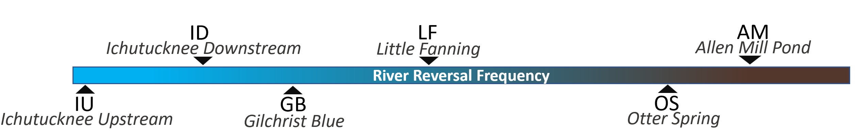
Methods: Study Sites
Two-Station Metabolism
One-Station Metabolism
downstream
Normal
Flooded
upstream
Riley & Dodds et al. 2023; Reichert et al., 2009; Demars et al., 2015
Notes:
To explore my hypothesis, I selected 5 spring-runs spanning a river-reversal frequency gradient including the iconic Ichetucknee river to the frequently reversing Allen Mill Pond; it spends half of the year brown.
I estimated each sites stream metabolism using two-station methods during normal conditions and one-station methods during flooded conditions.
The project is still ongoing, and I began monitoring these sites in late 2021

Slide 12
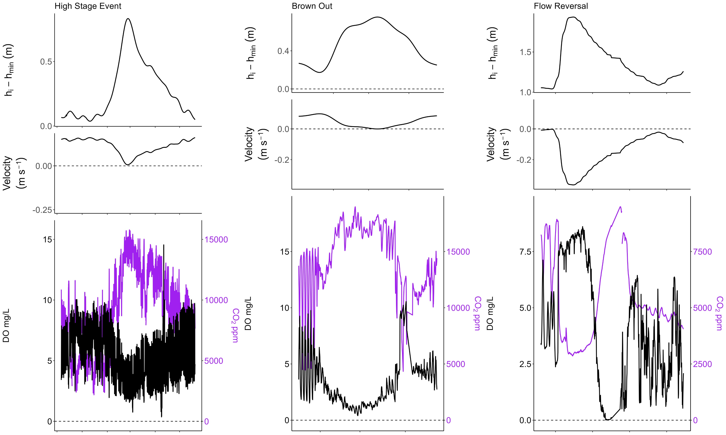
Dissolved oxygen (DO) decreased, and CO2 increased with increasing stage. River reversals caused hypoxia.
Notes:
Before any modeling, a pattern emerged. As stage increased, DO decreased and CO2 increased in tandem displaying strong coupling.
AND The degree in which DO and CO2 changed aligned with each flood's magnitude.
For instance, during high stage events, O2 decreased, and CO2 increased with increasing stage.
For river reversals, again, there is a fall in DO and an increase in CO2, but the spring-run became hypoxic
However, during a flow reversal, there is a spike in DO and then a dramatically fall.
This an indicator of a true flow reversal. The spike is the moment in which river water displaced the groundwater-fed spring at the sensor's location.

Slide 13
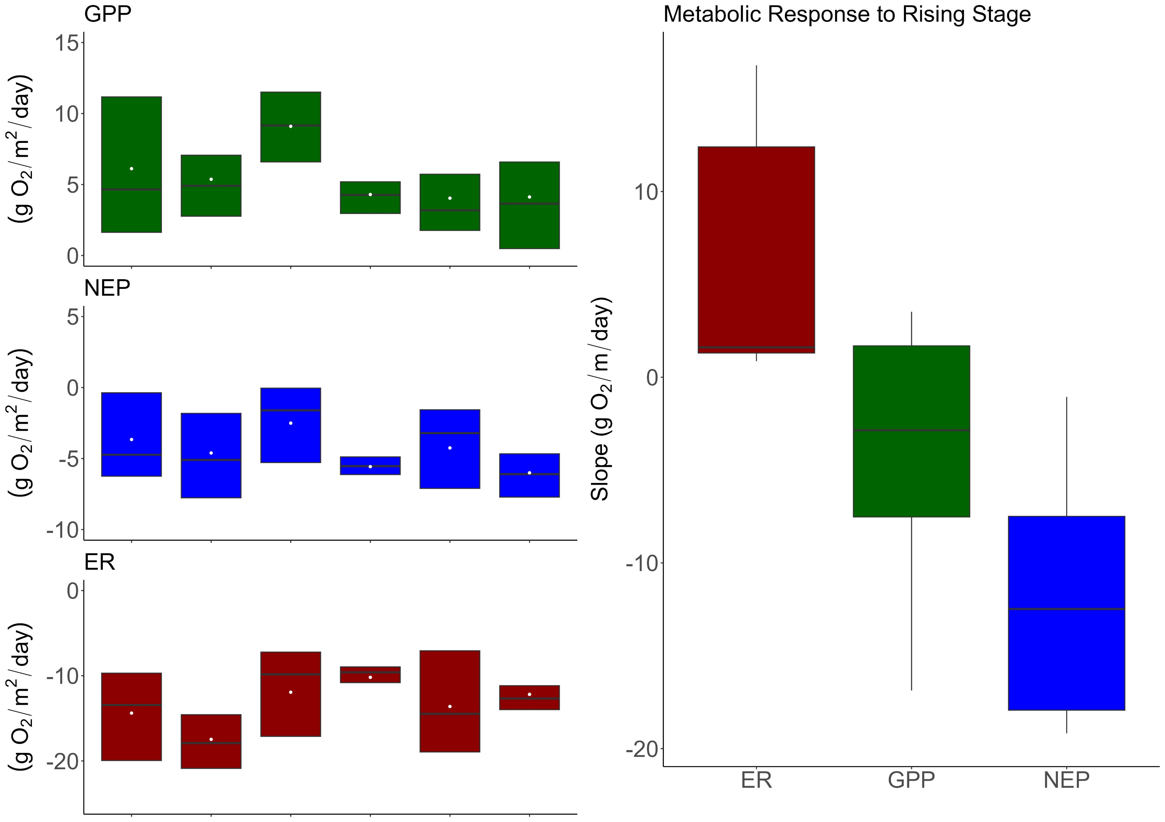
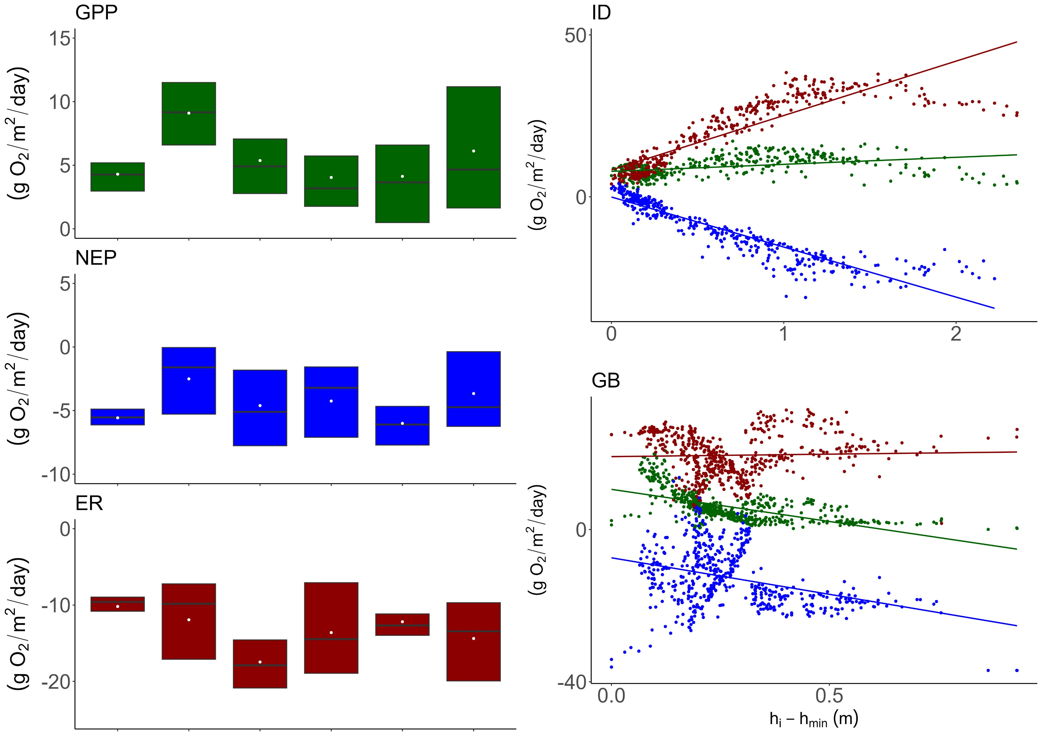
Stage and productivity have a negative relationship.
H1. Due to the occlusion of light, Spring-run productivity will decline and respiration rates will increase.
Notes:
Moving on, here are the metabolic regimes for my sites including disturbed and non disturbed periods.
Most of my sites were heterotrophic, and there were no distinguishable trends between metabolic regime and disturbance regime.
CLICK
On the left are scatter plots displaying the metabolic response to rising stage for two of my sites.
As expected, as stage increased, GPP decreased, and ER increased.
Click
The slope of each sites response to stage is summarized within these boxplots.
Across all the sites, ER increased and GPP decreased with increasing stage
resulting in a significant decrease in net ecosystem productivity (NEP)
CLICK
In short, when stage rose, productivity fell, regardless of disturbance regime indicating depth and flow are significant factors in spring metabolism for all runs

Slide 14
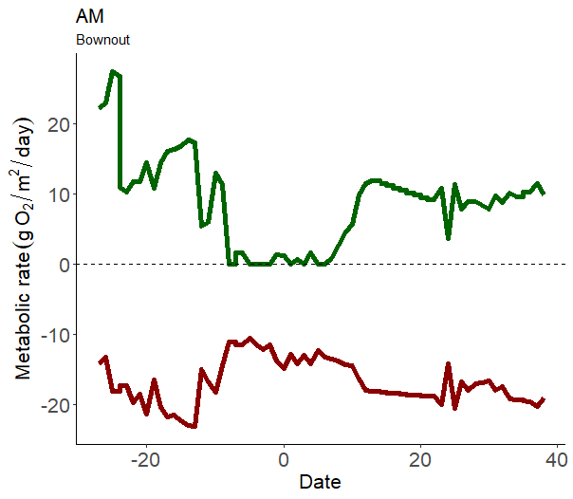

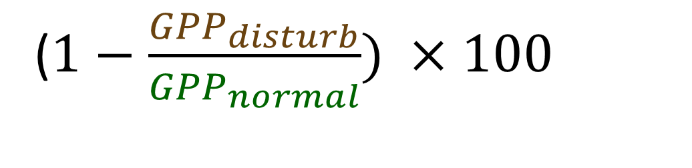

Is disturbance magnitude correlated with spring-run metabolic degradation?
Percent Reduction:
($1−\frac{{GPP}_{disturb}}{{GPP}_{normal}}) ×100$
($1−\frac{ER_{disturb}}{ER_{normal}}) ×100$
Reisinger et al. 2017
Notes:
Zooming in, I wanted to explore whether the flood impacts was dependent on the flood’s magnitude.
Using simple percent-reduction equations

Slide 15
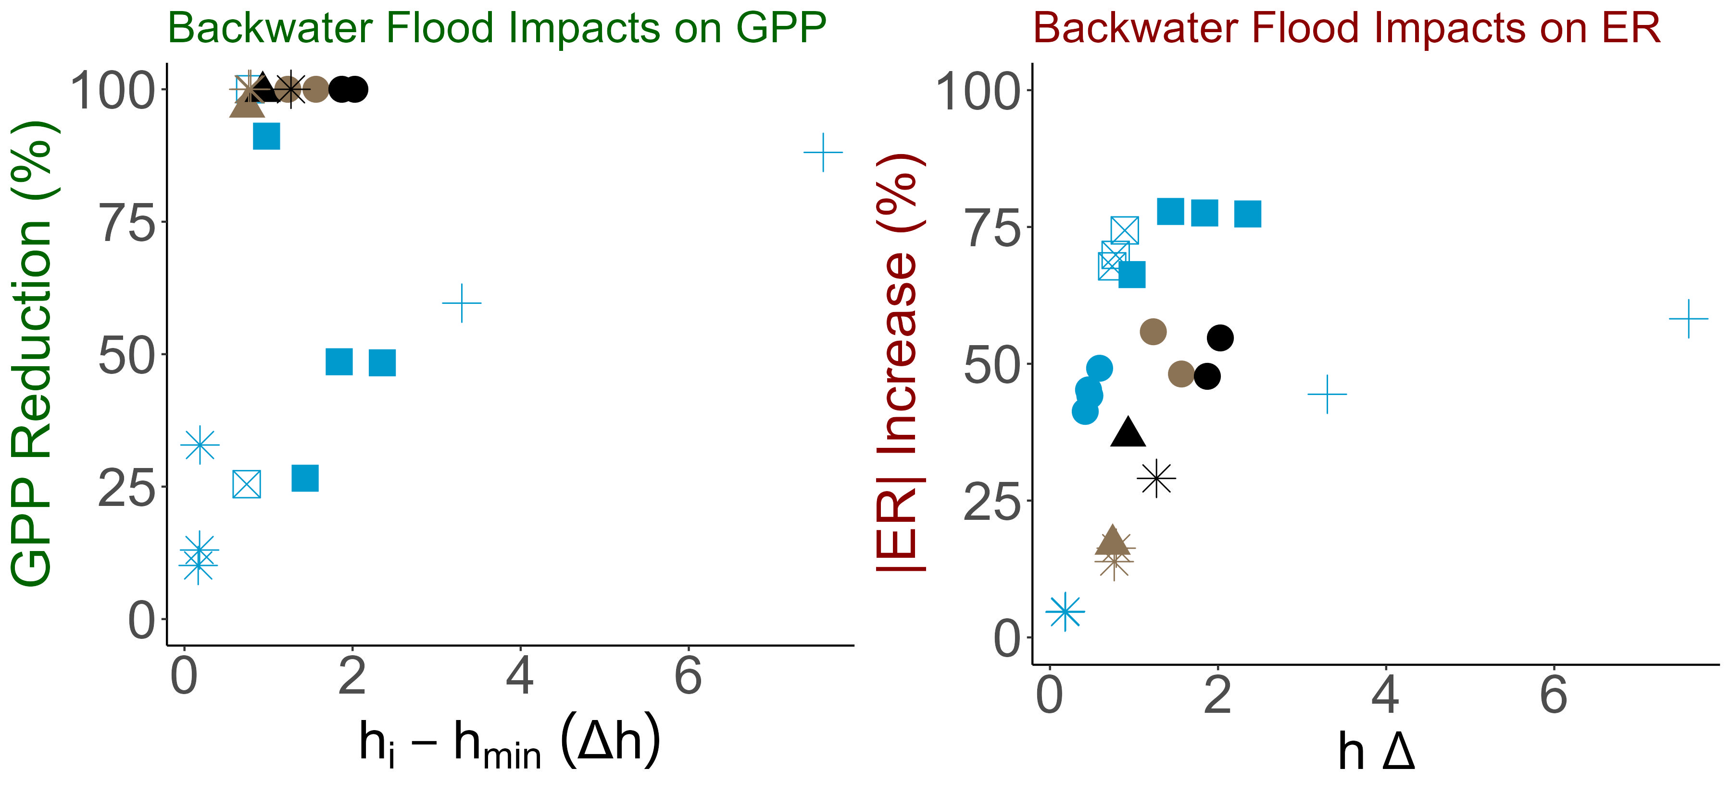
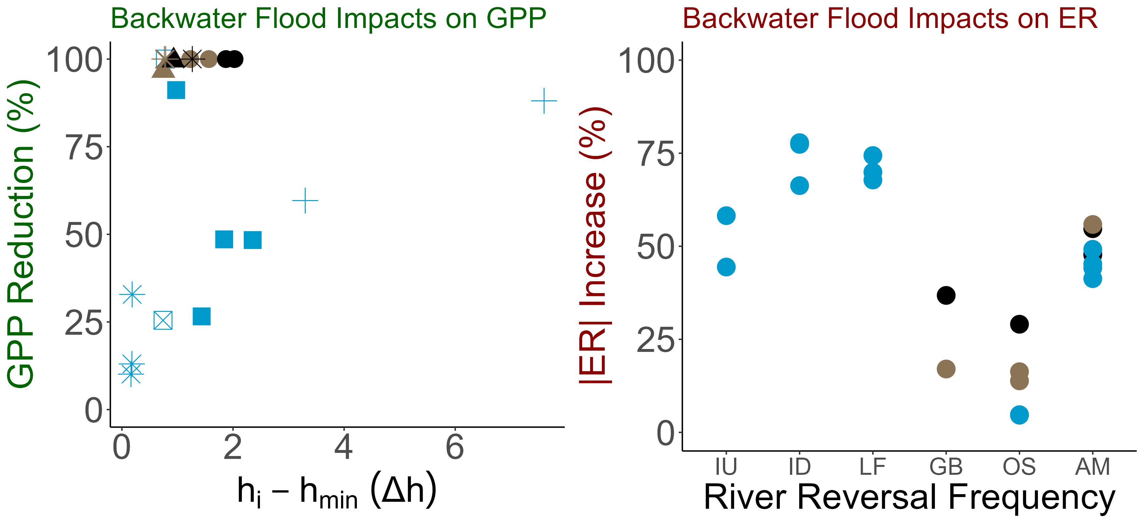

, ER tended to increase with increasing stage. River reversals drove GPP to 0.
H2. Flood magnitude will be positively correlated with metabolic recovery time and metabolic reduction.
H1. Due to the occlusion of light, Spring-run productivity will decline and respiration rates will increase
ER increases
GPP decreases
Notes:
In this figure, the x axis represents the difference between the stage minimum and the flood stage.
On the y axis I have the percent reduction
Once water become brown, GPP was diminished, regardless of flood magnitude CLICK
As or high stage events, GPP and stage have a negative relationship with GPP decreasing with an increase in stage. CLICK
ER rates tended to increasewith increasing stage, regardless if it was a high stage event or a river reversal
CLICK There seems to be some clustering among sites for ER but it seems minimal,
however, springs that reversed more frequently tended to see lower ER increases.
Bottom line, river reversals drove GPP to 0 while ER tended to increase with increasing stage.

Slide 16
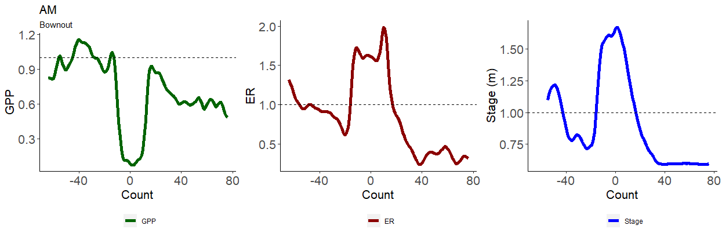
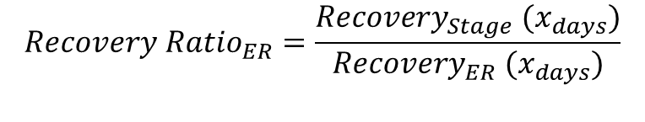
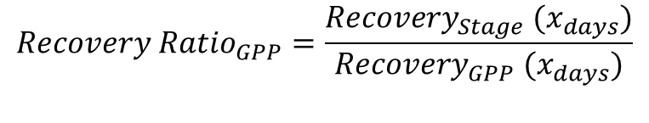
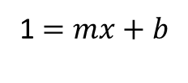
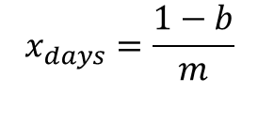
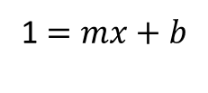
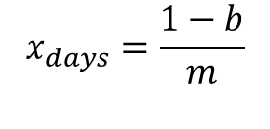
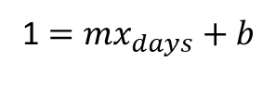
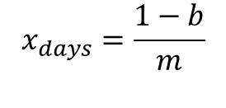
Is disturbance magnitude correlated with spring-run recovery?
$$x_{days}=\frac{1−b}{m}$$
$$x_{days}=\frac{1−b}{m}$$
$$x_{days}=\frac{1−b}{m}$$
1 $=mx_{days}+b$
1 $=mx+b$
1 $=mx+b$
$$Recovery Ratio_{GPP}=\frac{Recovery_{Stage} (x_{days})}{Recovery_{GPP} (x_{days})}$$
$$Recovery Ratio_{ER}=\frac{Recovery_{Stage} (x_{days})}{Recovery_{ER} (x_{days})}$$
Recovery Ratio > 1; Metabolism recovered quicker.
Recovery Ratio < 1; Stage recovered quicker .
Reisinger et al. 2017.
Notes:
Continuing this thread, is a spring’s recovery dependent on the flow regime or flood magnitude, or both?
For this, I fitted a linear regression between the height of the disturbance and when the spring-run recovered
I extracted this linear relationship to estimate recovery time
And then divided GPP and ER recovery by stage’s recovery and called these ratios, recovery ratios

Slide 17
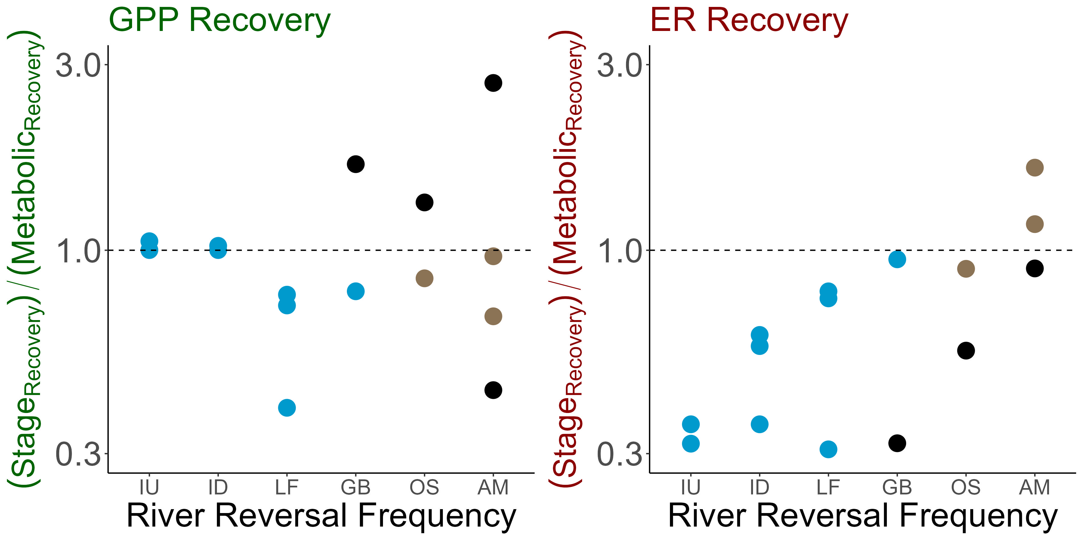
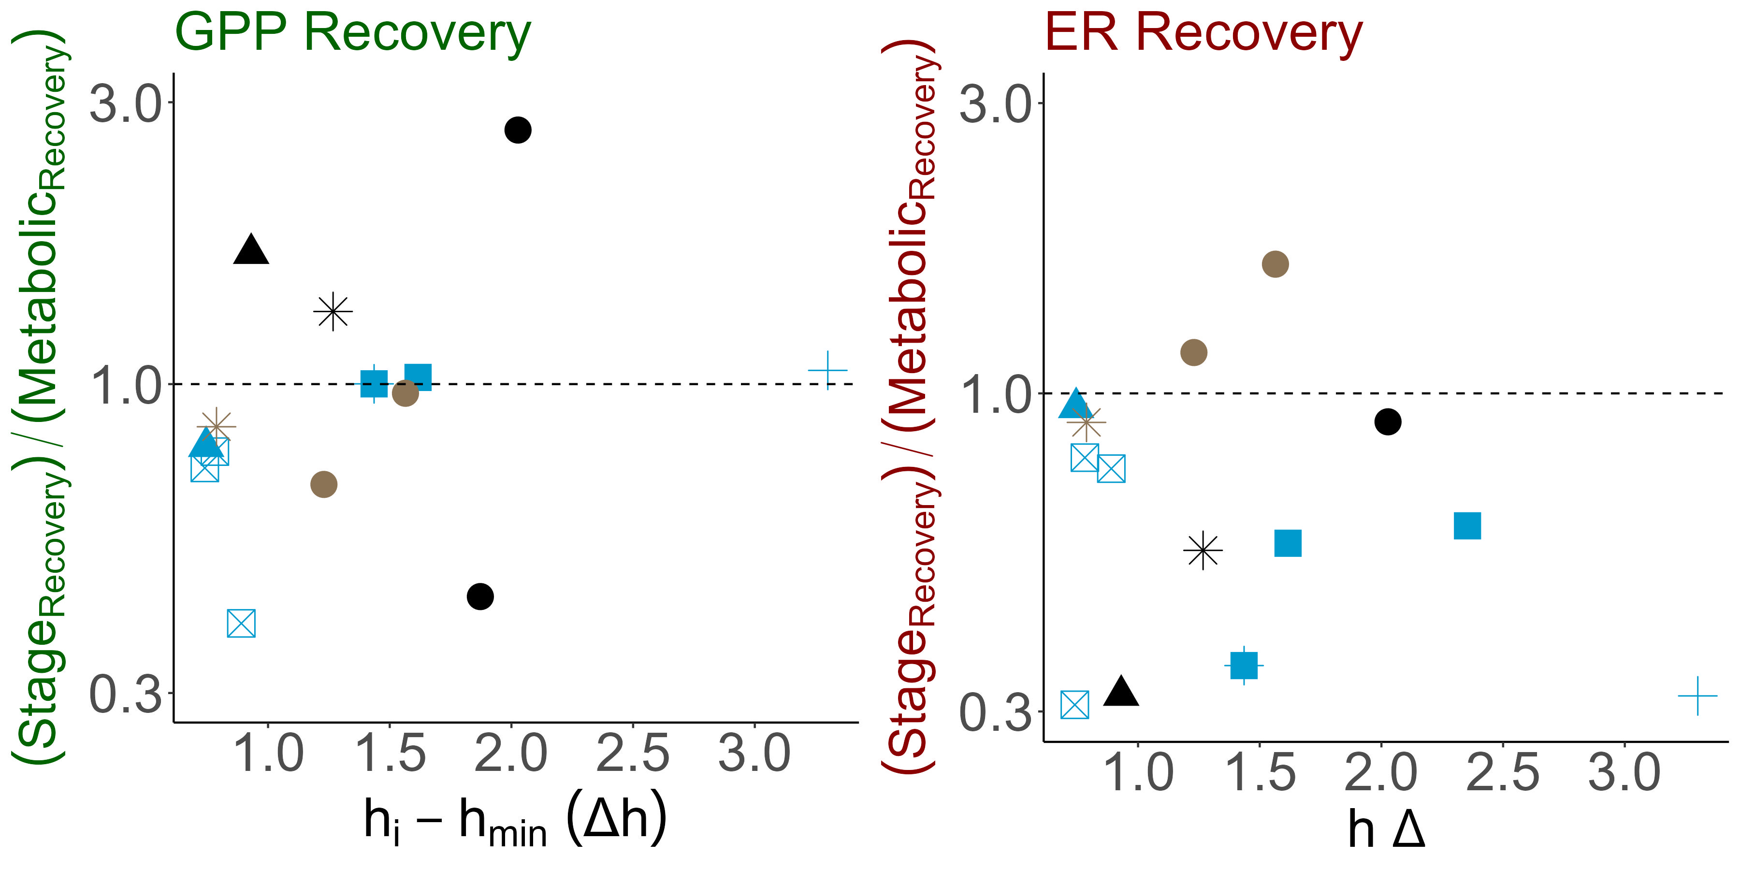
Spring metabolism recovered alongside or quicker than stage. ER recovered more quickly in more disturbed springs, and GPP took longer to recover with increasing stage.
H2. Flood magnitude will be positively correlated with metabolic recovery time.
Notes:
Here, on the y-axis I have the recovery ratios and on the x axis I have the difference between the stage minimum and the flood stage.
click
In most cases, both GPP and ER recovered along-side or faster than stage whether a high stage event or a flow reversal
As for disturbance regime, a clear positive relationship is seen between ER recovery and disturbance regime. The more disturbed the site, the quicker ER was able to rebound.
In the literature, a similar relationship is seen with other frequently disturbed streams. It is thought that frequently disturbed streams adapted to their fluctuating flow regimes, allowing for productivity under less-than-ideal conditions. This may be what’s happening here. CLICK
GPP recovery did not have any obvious relationships with disturbance regime but none the less… click

Slide 18
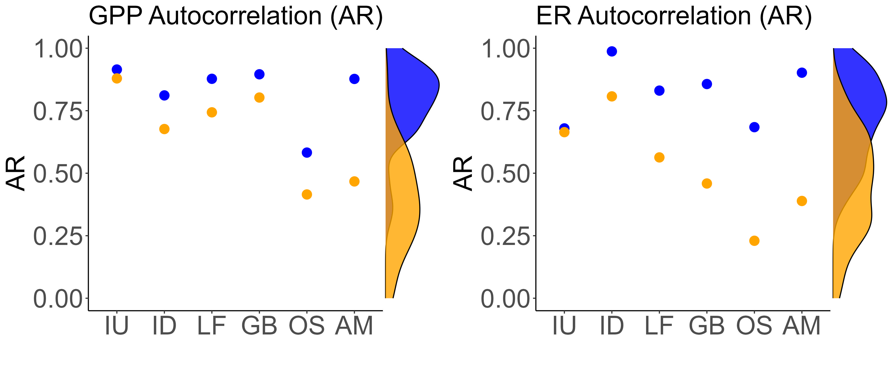

Less disturbed spring-runs had more stable metabolic regimes than more disturbed spring-runs.
H3. Frequently disturbed springs will have less stable metabolic regimes than rarely disturbed springs.
Appling et al. 2020.
Notes:
Lastly, with these results in mind, I wanted to investigate whether more disturbed springs had less metabolic stability during normal, non-flooded periods
Here I present the autocorrelation for each of my sites. The density data on the site is from Appling et al. 2020, displaying the autocorrelation for ~50 flowing waters.
CLICK
CLICK
My site followed the expected pattern with less disturbed sites having greater autocorrelation than more disturbed sites.
Furthermore, these springs CLICK were often more correlated than Applings 50+ streams and rivers

Slide 19


Indicating light availability is a major factor in spring-metabolism
H1. Spring-run productivity will decline during floods, despite the absence of bed scour
H2a. Flood magnitude will be positively correlated with metabolic reduction time.
Bernhardt et al. 2018; Mullholand et al. 2001; Hensley et al. 2017; Uehlinger et al. 2000; Donsky 2023
Notes:
Which paints a unique picture of spring-run metabolic regime
There was a significant, negative relationship between stage and productivity CLICK
However, once light was extinguished by a river reversal, GPP became 0 regardless of flood magnitude CLICK
Indicating light availability is a major factor in spring metabolism.
If light is attenuated, the spring-run will have a metabolic response.
Furthermore, for river reversals, the swapping of headwaters is not important. If the run is shaded by tannic, river water, spring productivity will halt.

Slide 20
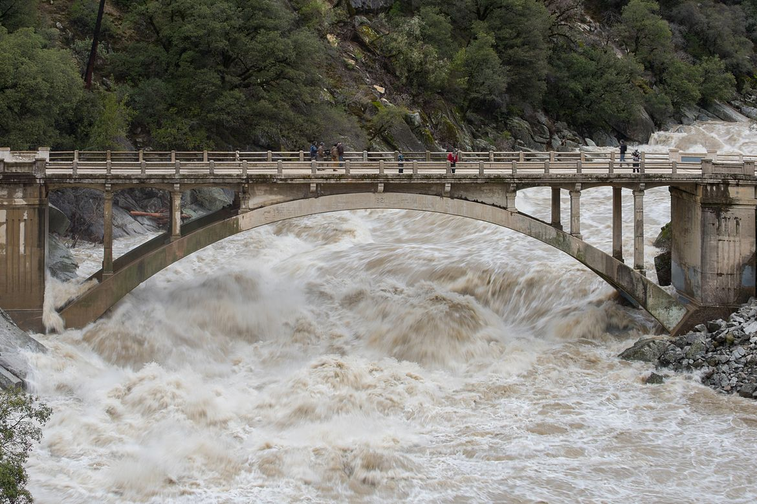

Light availability determines productivity, but the degree of bed scour decides the rate of recovery
H2b. Flood magnitude will be positively correlated with metabolic recovery time.
Notes:
Furthermore, spring metabolism often recovered faster or along side stage.
This may be due to the absence of bed scour during floods. CLICK
Since the spring-runs retain their benthos, once light returns, they can immediately begin photosynthesizing allowing their metabolism to recover quickly.
If this is true, light may be a determining factor in flow waters metabolism but its bed scour that decides the rate of recovery.

Slide 21

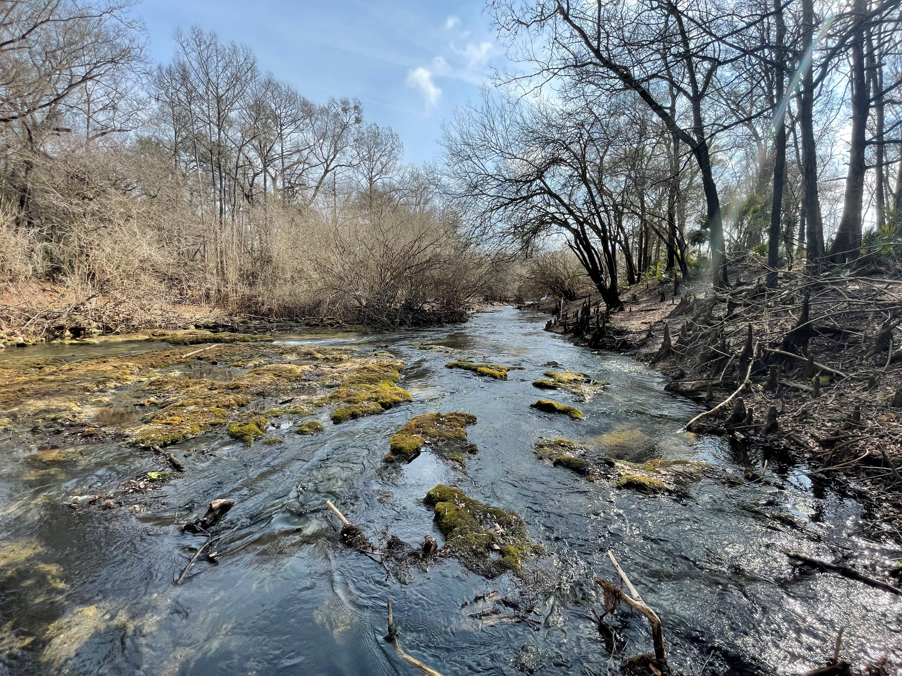
H3. Frequently disturbed springs will have less stable metabolic regimes than rarely disturbed springs.
Ichetucknee Headspring
Allen Mill Pond
Rum Island Springs
Disturbance Regime~ Metabolic Stability
Notes:
And lastly, I found North Florida spring-runs span a gradient of flow regimes dependent on their disturbance regime where some springs flood and others do not

Slide 22




































































… and as such, disturbance is a key factor in spring-run regime and function
CO₂
CO₂
CO₂
CO₂
CO₂
CO₂
CO₂
CO₂
CO₂
CO₂
CO₂
CO₂
Thank you!
samanthahowley@ufl.edu
Notes:
And as such, disturbance is a key factor in spring-run metabolic regime and function, like any other flowing waters
Thank you!

